Slide 1
DATA ANALYSIS OF CRIMES IN CHICAGO Susmitha Rudraraju

Slide 2
CONTENT
Project
Data Description
Flow Chart
Data Visualization
Feature Selection and Correlation Matrix
Data Models
Evaluation of Results
Conclusion

Slide 3
Project
Crime has been a major issue in the current world and has been increasing rapidly since past few years. The rate at which the crimes have been increasing is creating a chaos in the United States.
Classifying the crime rates that occurred in different locations and sending this data can be helpful for the police department to protect the public by identifying the underlying areas to protect people and provide safety.

Slide 4
Chicago is one of those states where crime rate has been more. By using dataset from Kaggle ‘Chicago Crime from 01JAN2001 to 22JUL2020’ we will perform data analysis, check different types of crimes occurring and give the information to the police department and take necessary steps based on the type of crime.
The main aim of the project is to perform Data Collection, importing data, plotting various Data Visualization graphs, implement different Machine Learning algorithms and finally evaluate the model that gives better accuracy in predicting the type of crimes which will help the police department in taking necessary actions to provide safety of the people.

Slide 5
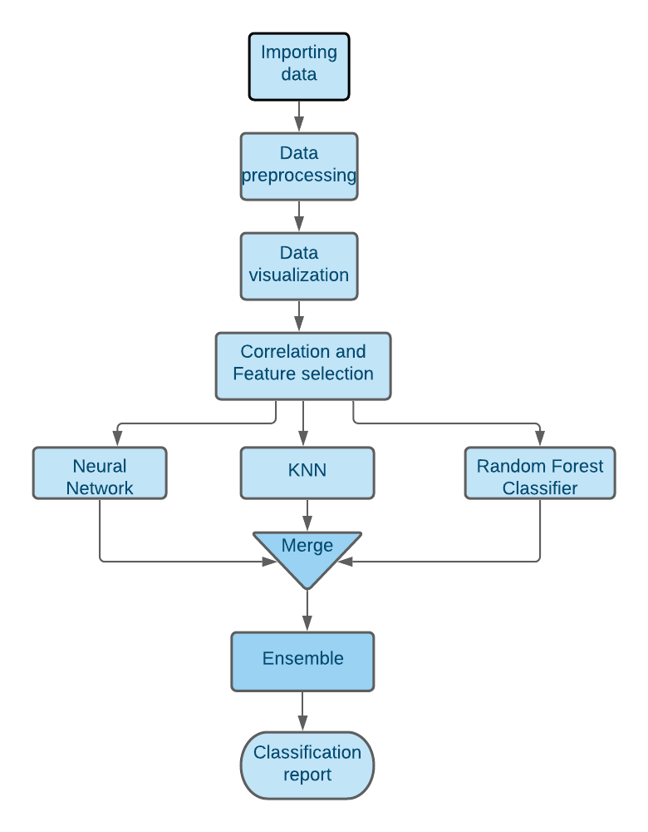
Flowchart

Slide 6

Dataset Description
The dataset “Chicago Crimes Dataset” (https://www.kaggle.com/n3v375/chicago-crime-from-01jan2001-to-22jul2020) has been imported from Kaggle and it consists of 22 columns and I have taken a sample of 80000 as the dataset is huge.
It comprises of reported incidents of crime (with the exception of murders where data exists for each victim) that occurred in the City of Chicago from 2001 to 2020.

Slide 7
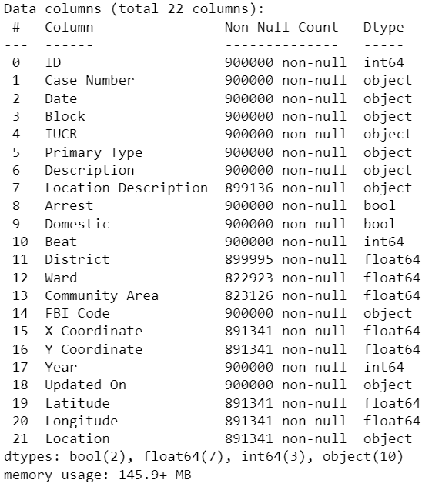

Slide 8
Data Pre-processing
Removing Null values
Changing Datatypes
Changing Datetime column
Changing column name

Slide 9
Data Visualization

Slide 10

Word cloud
In word cloud ,
Theft, Battery, Criminal
damage, Narcotics and
Assault which occur
maximum number of
times are displayed in
bigger font.

Slide 11
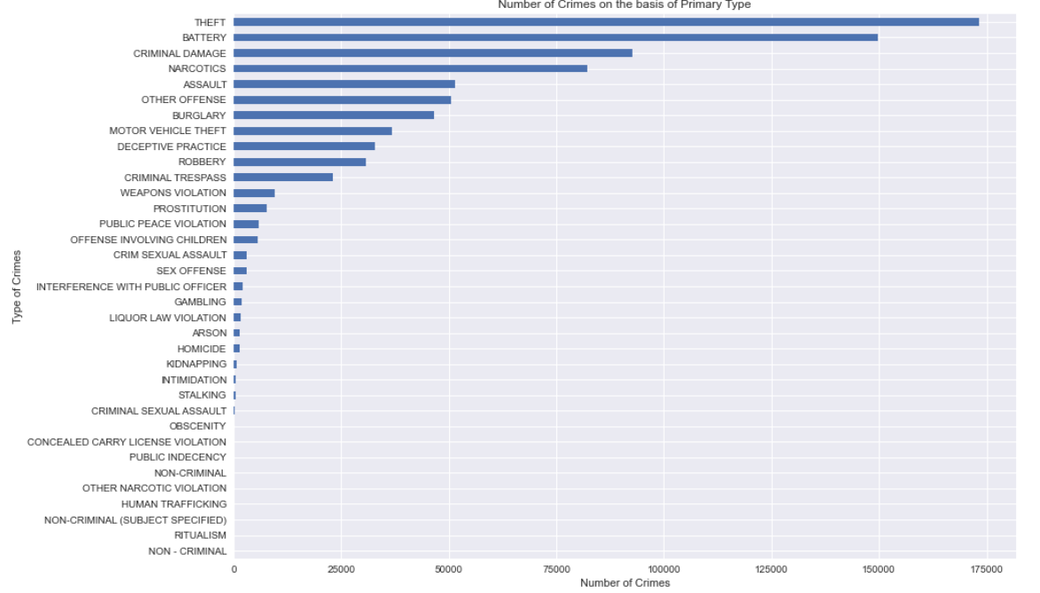
Occurrence of crimes
Bar graph shows
the number of crimes
that are displayed based
on primary type.

Slide 12
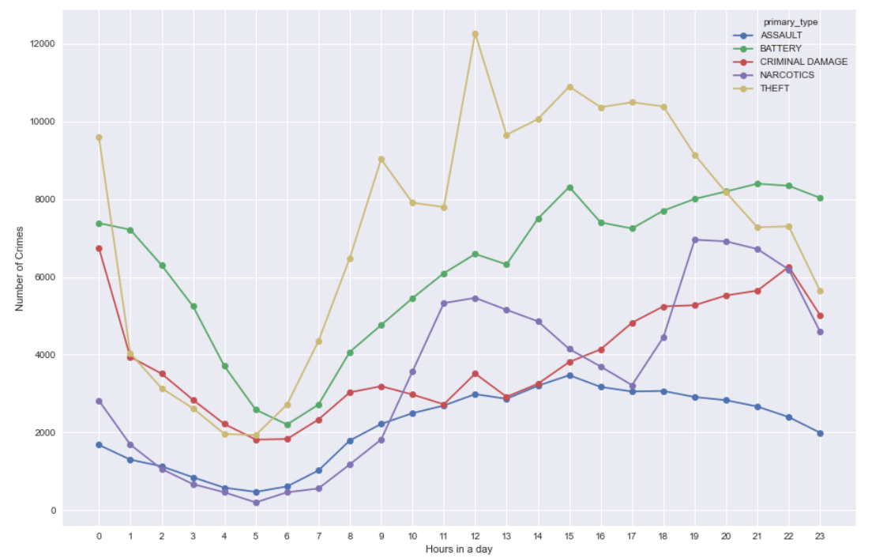
Time series graph
Time series graph shows
the crimes occurred
in less than 24hrs.

Slide 13
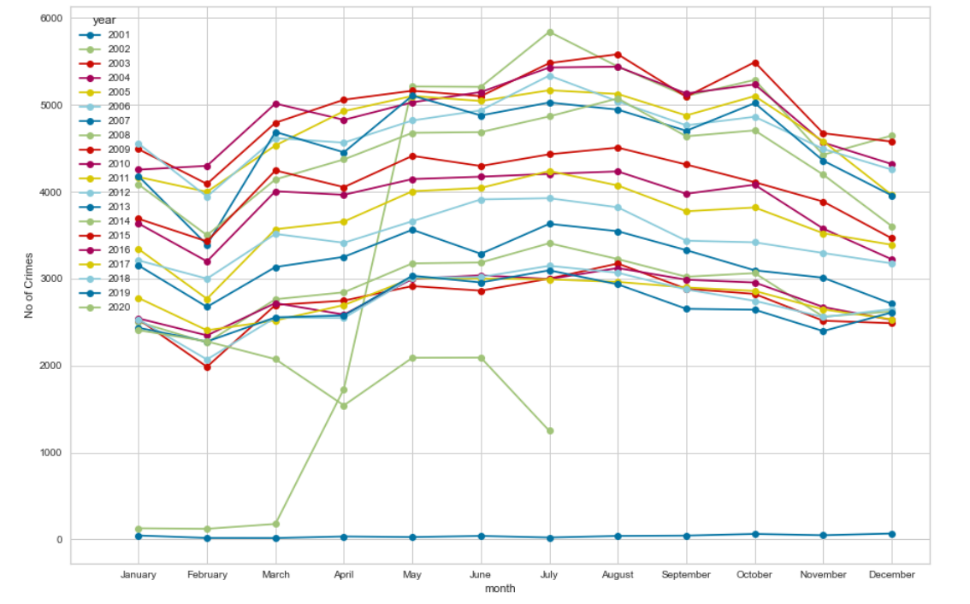
Time series graph
It shows the crimes
occurred monthly
for all years.

Slide 14
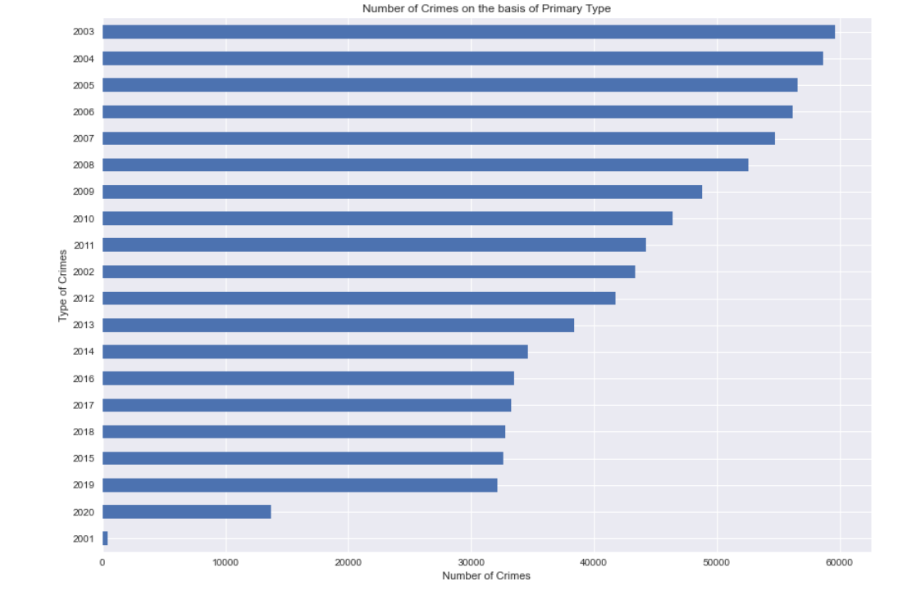
Bar plot
Number of crimes based
on primary type from
2001-2020

Slide 15
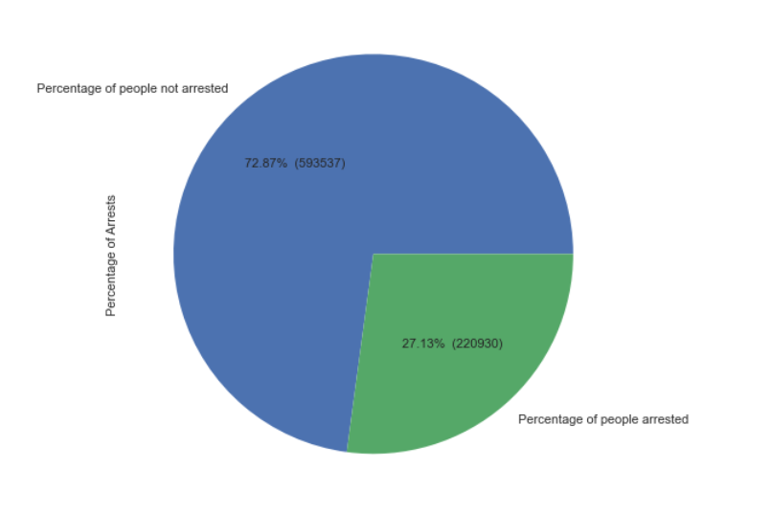
Pie chart
Percentage of arrests

Slide 16
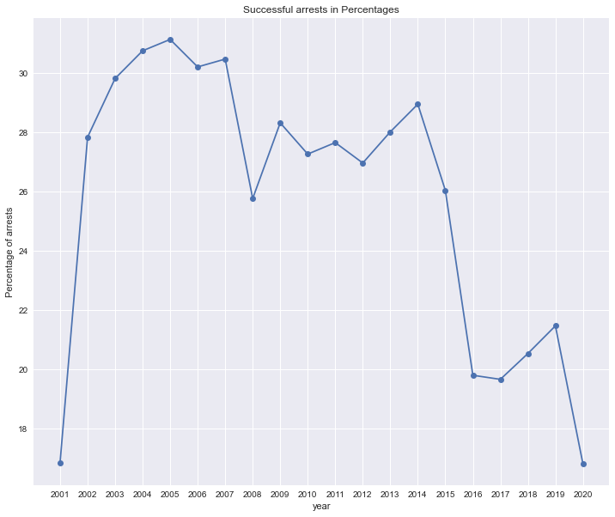
Successful arrests
Successful arrests in
percentages from
2001-2020.

Slide 17
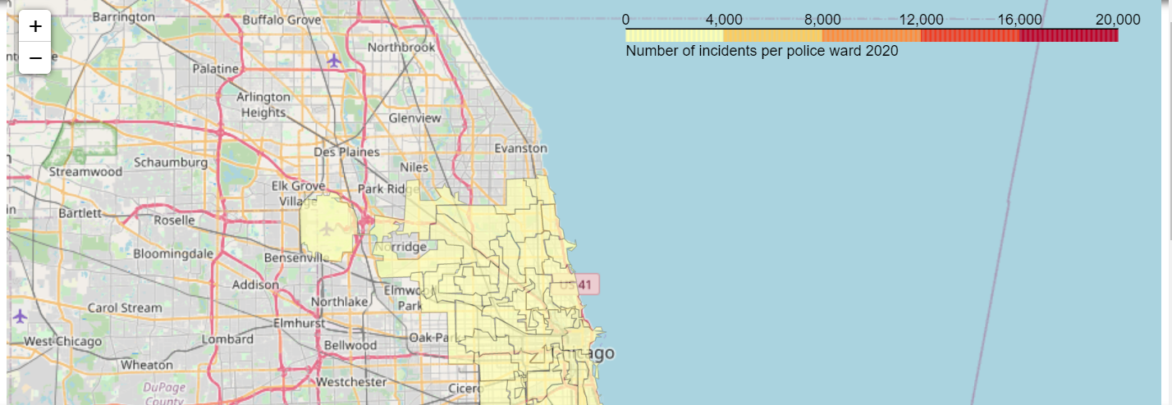
Number of incidents per police ward 2020

Slide 18
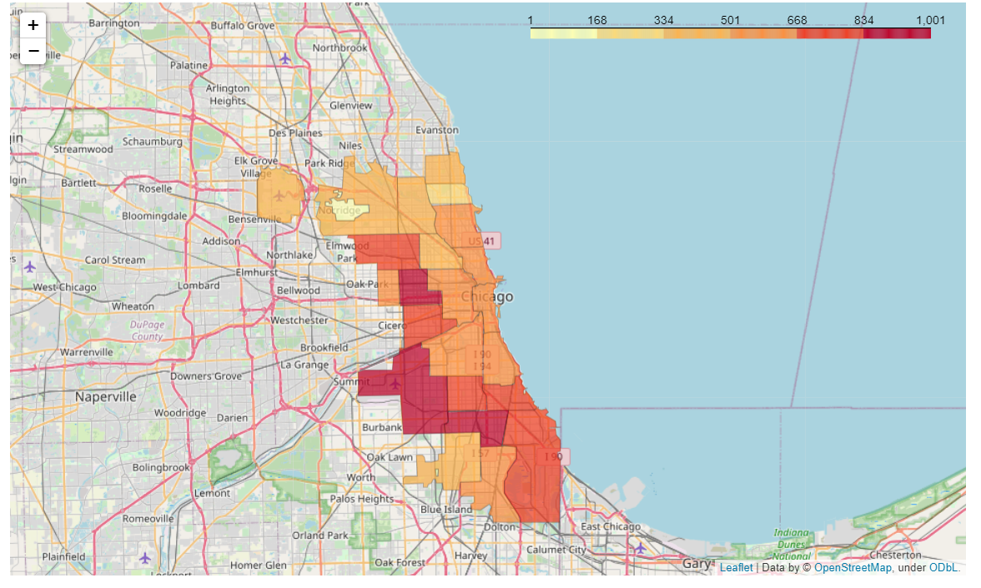
Number of incidents per police district 2020

Slide 19
Feature selection & Correlation MATRIX

Slide 20
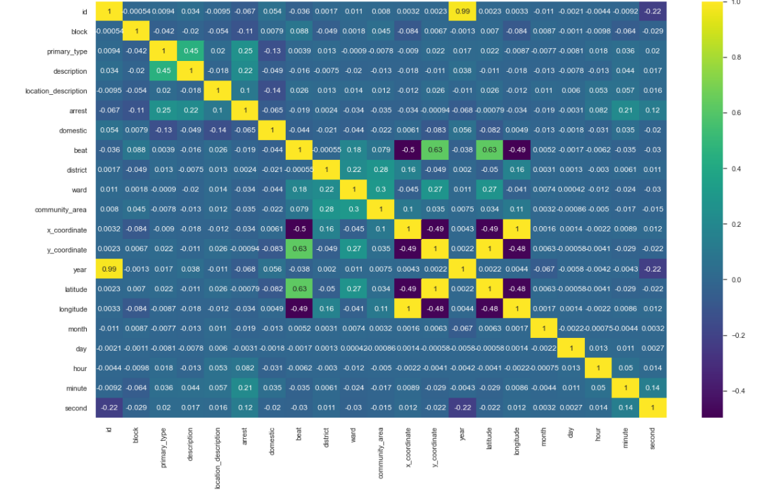
Correlation matrix
We have converted few
columns to numeric values and
plotted a heatmap

Slide 21
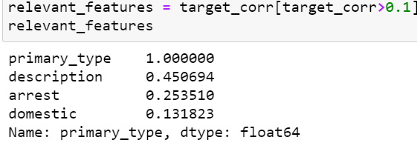
Feature Selection
Feature selection is done by taking the correlation values above 0.1.
From the results we can see that Description, Arrest and Domestic have
been more correlated for the model which we will use in train and test data.

Slide 22
Data Models

Slide 23
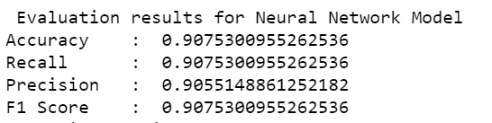
Neural Networks using MLPClassifier
Accuracy, recall, precision and f1-score has been printed after training
and testing the model using neural networks.

Slide 24
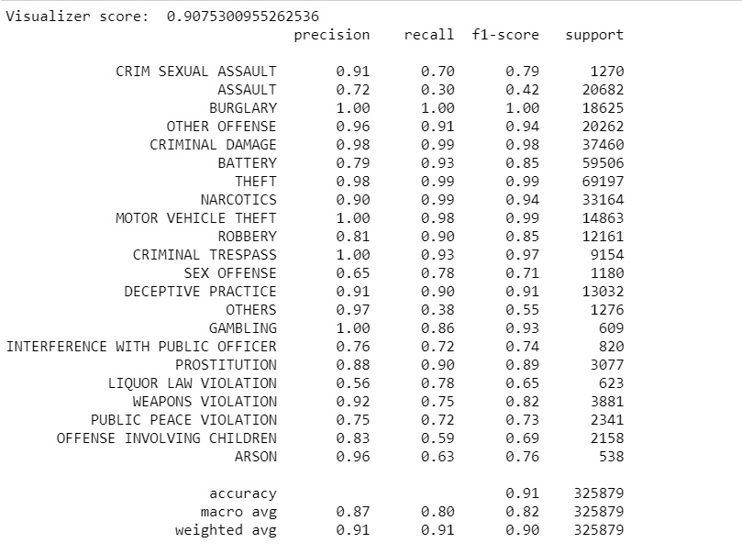

Slide 25
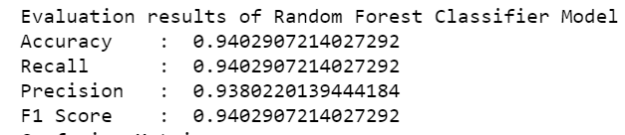
Random Forest Classifier
Accuracy, recall, precision and f1-score has been printed after training
and testing the model using random forest classifier.

Slide 26
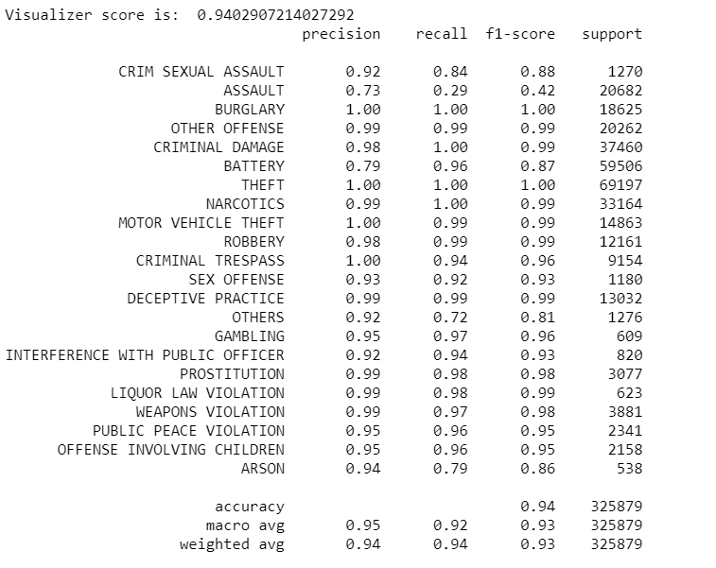

Slide 27
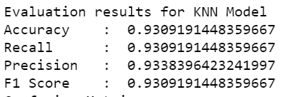
KNN Model
Accuracy, recall, precision and f1-score has been printed after training
and testing the model using KNN.

Slide 28
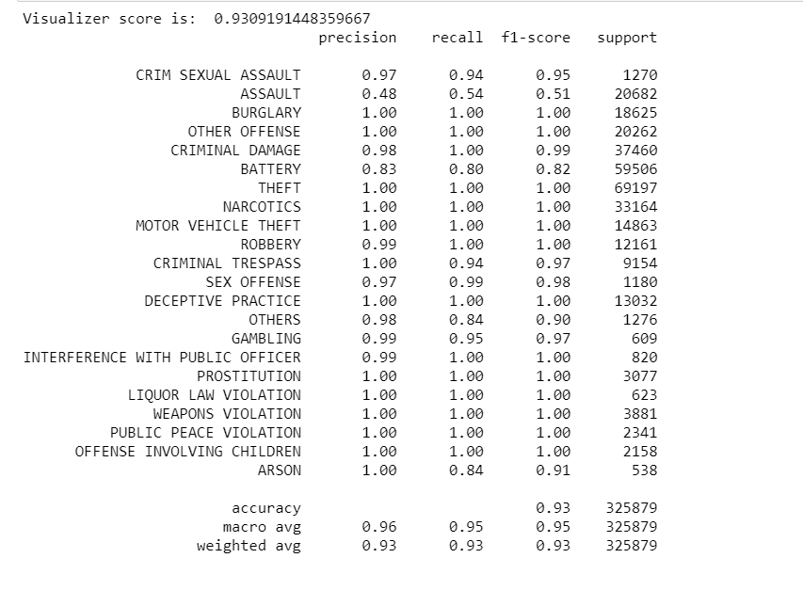

Slide 29
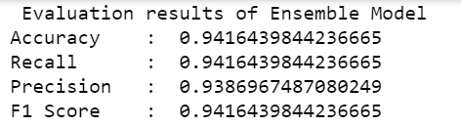
Ensemble Model
Accuracy, recall, precision and f1-score has been printed after training
and testing the model using ensemble.

Slide 30
Evaluation of Results
The models that we performed were Neural Network using MLPClassifier, Random Forest, KNN model.
NN using MLPClassifier has an accuracy of 90%, but the execution speed is very slow compared to other models.

Slide 31
Random Forest Classifier has an accuracy of 94% and the execution time is faster than other models.
KNN model has an accuracy of 93%.
Finally, in Ensemble model even thought if it has less execution speed it combines all the models together to give a little better accuracy of 94.1% which is almost close to Random Forest Classifiers accuracy.

Slide 32
Conclusion
Random forest has a better accuracy with less execution time, but whereas Ensemble model has a little better accuracy than Random Forest model.
Data Visualization shows graph with areas and reasons why and where crimes have been occurring more that can be helpful for Police Departments to provide security for the people of Chicago.

Slide 33
Thank you

